Slide 1
Establishing Goals for the Billing Office
Kathy Puziak PMP CMPE
KPG Revenue Cycle Management, Inc.

Slide 2
© 2015 KPG Revenue Cycle Management, Inc. All rights reserved.
This presentation does not constitute a representation or warranty or documentation regarding the product or service featured. All illustrations are provided as fictional examples only. Your product features and configuration may be different than those shown. No part of this publication may be reproduced for any purpose without written permission.

Slide 3
Reaching for the Gold Standard
People
Internal monitoring of systems
Processes
Coding
Third-party AR and denial management
Collections
Reporting and measuring
Technology
Managed care contracting and fee schedule reviews

Slide 4
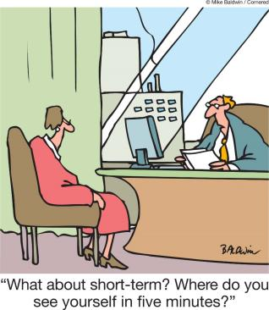
Set Expectations

Slide 5

Set expectations!
Established goals for the billing department
Put them in writing

Slide 7
Establish Goals for KPI’s
Days in Account Receivables
Days in Account Receivables
  Better Performing Practices 28.73*
Defined as the total accounts receivable divided by 1/365 of gross charges. Days in accounts receivable demonstrates the time for service delivery to claim payment. This number fluctuates based upon specialty and market and is higher in practices using paper versus electronic medical records.
*MGMA Performance & Practices of Successful Medical Groups 2014 Report

Slide 8
Establish Goals for KPI’s
Percentage of Ageing Over 120 Days
Percentage of Ageing Over 120 days
  Better Performing Practices 7.35% Re-aged*
  Better Performing Practices 8.8% Non re-aged*
The amount of monies due a practice is referred to as it’s total accounts receivable. Monies outstanding should be as “young” as possible, as a dollar today is more valuable than a dollar tomorrow. Monies in accounts receivable > 180 days is generally considered bad debt or uncollectable.
*MGMA Performance & Practices of Successful Medical Groups 2014 Report

Slide 9
Establish Goals for KPI’s
Adjusted Collection Ratio
Adjusted Collection Ratio
  Better Performing Practices 98.7%*
This is significant as it represents revenue. It is defined as the net FFS payments divided by gross charges less contractual write-offs, discounts, courtesies and bad debt. Well run medical practices have a net fee for service collection rate close to 100 %.
*MGMA Performance & Practices of Successful Medical Groups 2014 Report

Slide 10
Establish Goals for KPI’s
Denial Rate
Denial Rate 5%
This benchmark looks at the percentage of time a claim is not paid. It is calculated by dividing the number and dollar value of denied line items by the total claims filed to a payer, (number and total charge amount). Better performing practices have denial rates below 5 %. Payers expect that only a small percentage of medical practices will follow up on claim denials, and as such, leave money on the table.
*MGMA Performance & Practices of Successful Medical Groups 2014 Report

Slide 11
What else should you be tracking?
Accounts receivable aging—patient balances
Accounts receivable aging—insurance by payer
Credit report—line item and account total
Unallocated/undistributed payments, summary
Adjustment report—by adjustment type and operator
Financial summaries with payments, charges, and adjustments

Slide 12
What else should you be tracking?
Co-pay collection rates
Electronic claim filing success rate
Turn around time for charge entry, payment entry, and denial resolution
Bad debt percentage

Slide 13
Set Expectations by Job Function
Set time frames
Set thresholds
Set goals

Slide 14


Slide 15
Questions?

Slide 16
Contact Information
Kathy Puziak, PMP CMPE
KPG Revenue Cycle Management, Inc.
Consulting, Training, Speaker
Las Vegas, Nevada
kathy.puziak@kpgrcm.com
303-478-3828

